Slide 1
TASK - 3
EXPLORING THE WEBSITE AND FINDING VULNERABILITY IN IT
Kanthimathi.C

Slide 2
PROBLEM STATEMENT:
In this task you are completely free. http://testasp.vulnweb.com/ - This is the website. Explore the website and try to find vulnerabilities in the website and report it to us. You will be evaluated on your methods and the report you submit. Don’t worry about evaluation, just report the vulnerabilities as you feel comfortable.
Make sure your report matches this >> #751870 Reflected XSS in pubg.com (hackerone.com)
You are expected to include the following in the final Report that you have to submit.
1) Proper Steps
2) ScreenShot
3) Video

Slide 3
REPORT
TITLE: Reflected XSS attack on http://testasp.vulnweb.com/
DOMAIN: vulnweb.com
SUBDOMAIN: testasp.vulnweb.com
TOOL USED: Burp Suite
SEVERITY OF THE ISSUE: High
ATTACK PERFORMED ON: Search bar of the website
CODE USED: <script>alert(1)</script>

Slide 4
STEPS TO REPRODUCE:
Step 1: Open the website http://testasp.vulnweb.com/ using Firefox on virtual Kali Machine.
Step 2: Then open Burp Suite application and start a temporary project in it.
Step 3: In Firefox browser, open XSS payloads present in github and copy them as raw text.
Step 4: Switch on proxy settings in both burp suite and browser.
Step 5: Type the javascript command <script>alert(1)</script> on the search bar of the website and click on search.

Slide 5
Step 6: Then in burp suite send the commands to intercept and repeater.
Step 7: Filter the add command to search bar and in the intruder section.
Step 8: Add the copied payload in the payload section of the intruder then start attack.
Step 9: Now, right-click on the burp suite window and click on open in browser.
Step 10: Copy the link shown in burp suite and paste it on the firefox browser.
Step 11: Before hitting search button make sure to turn of the proxy setting in browser and burp suite, then search.
Step 12: Now in the website you can find and alert box with text 1 which means the XSS payload got executed in it.

Slide 6
IMPACT OF THIS ATTACK:
XSS can have huge implications for a web application and its users. User accounts can be hijacked, credentials could be stolen, sensitive data could be exfiltrated, and lastly, access to your client computers can be obtained.
SOLUTION:
XSS vulnerabilities exist due to the absence of two countermeasures – input validation and output encoding. Together, these controls restrict impact by sanitizing the user’s input to remove special characters and then encoding any remaining special characters before returning the content to the user.

Slide 7
SCREENSHOTS & VIDEO PROOFS

Slide 8
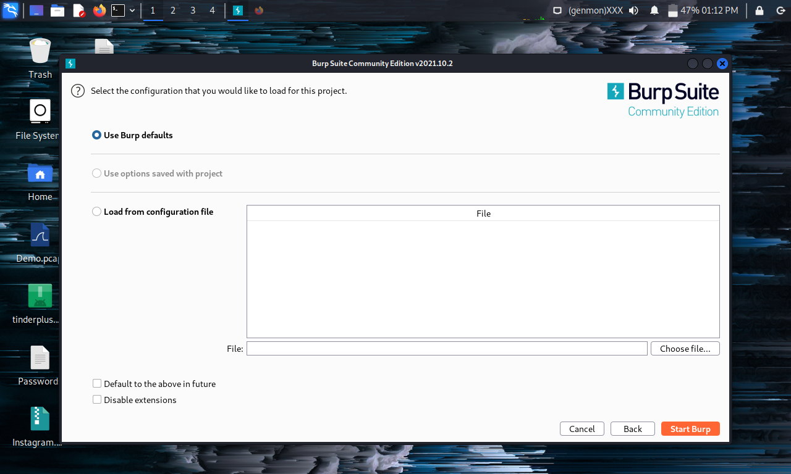

Slide 9
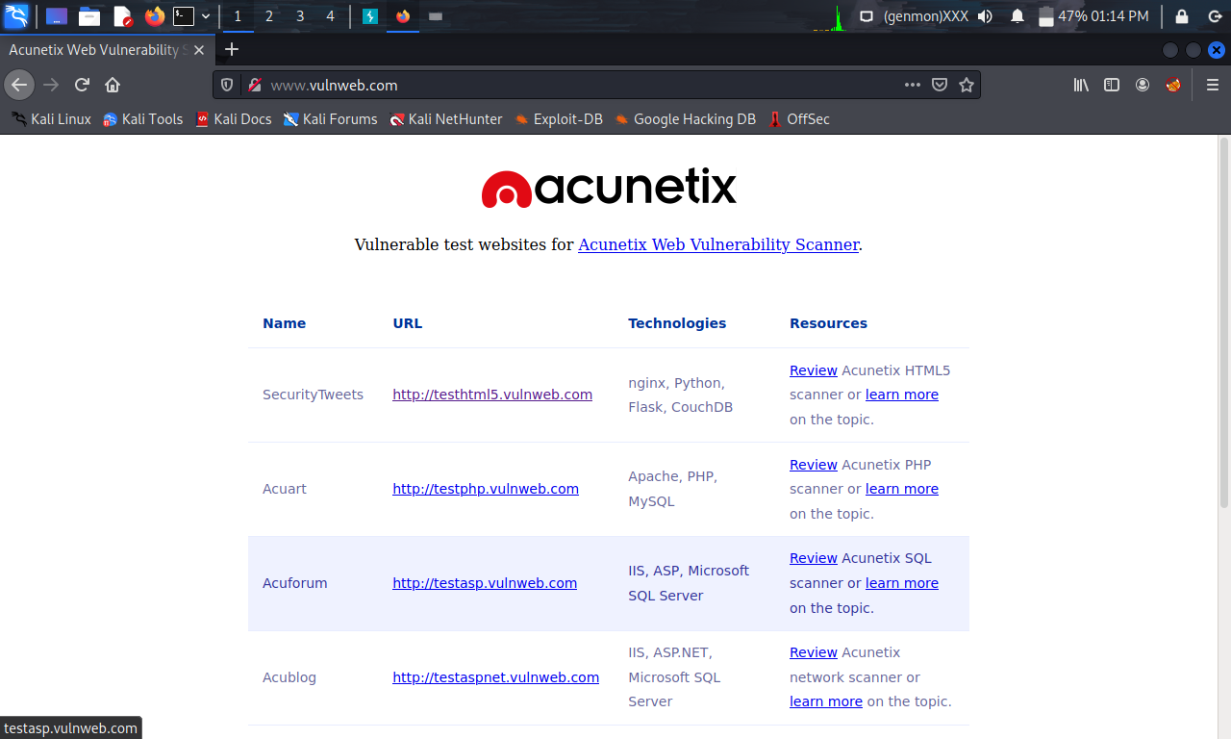

Slide 10
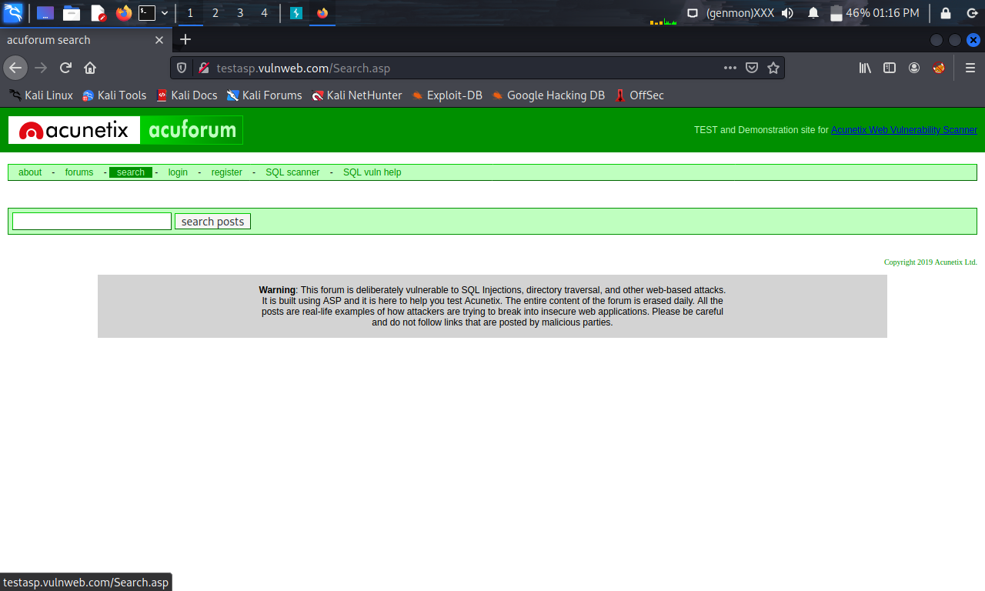

Slide 11
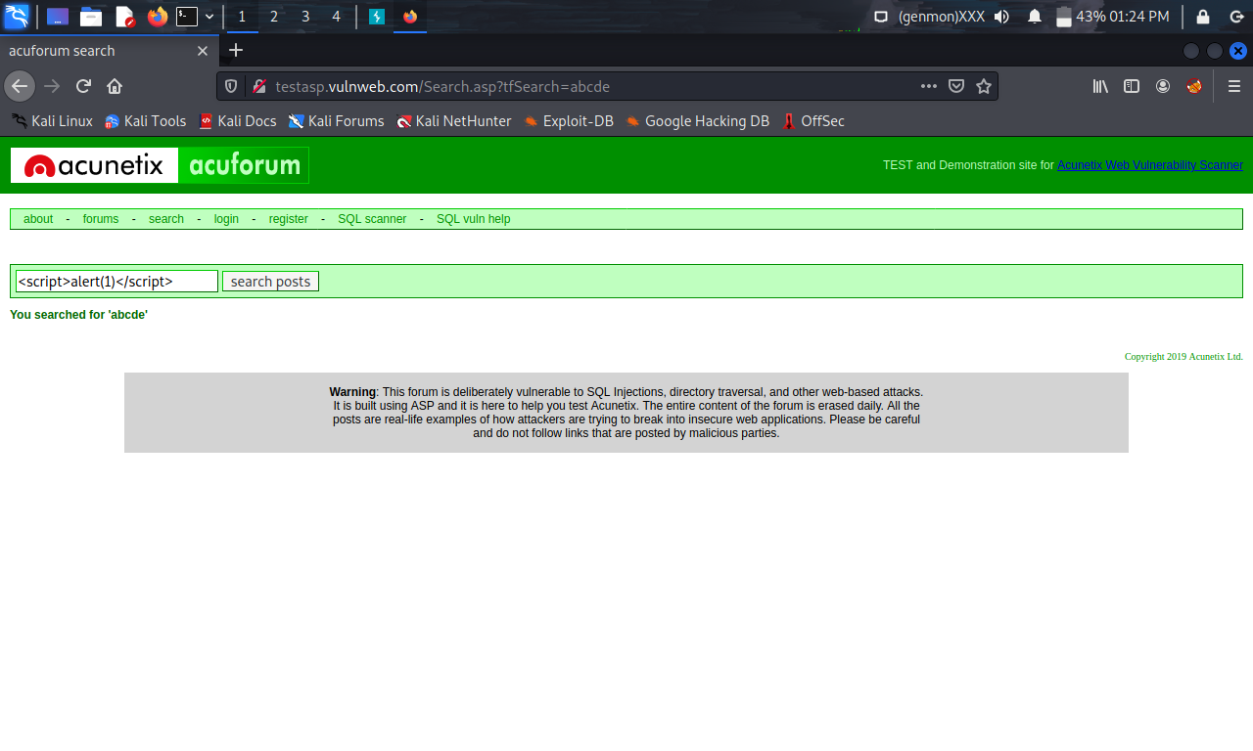

Slide 12
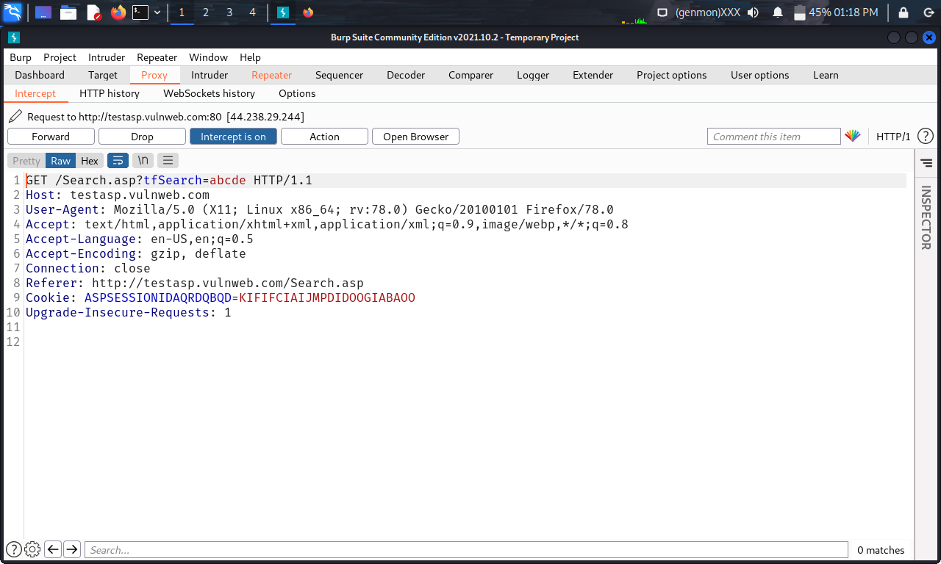

Slide 13
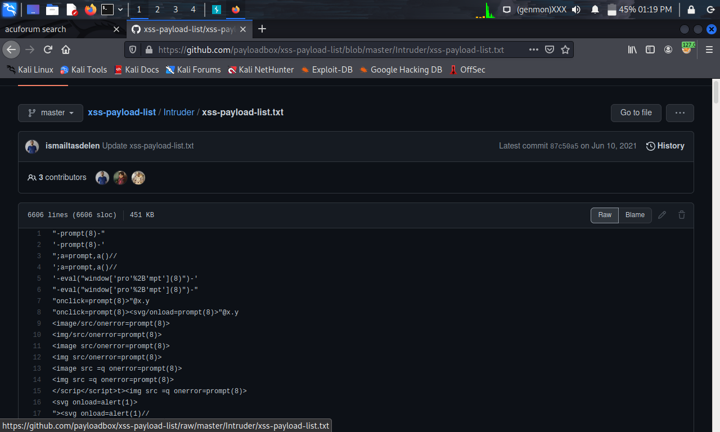

Slide 14
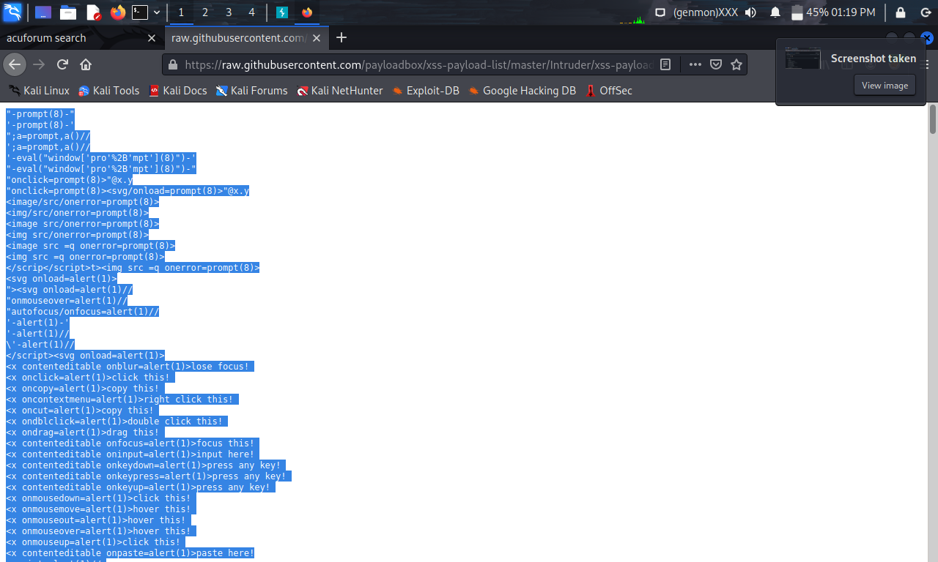

Slide 15
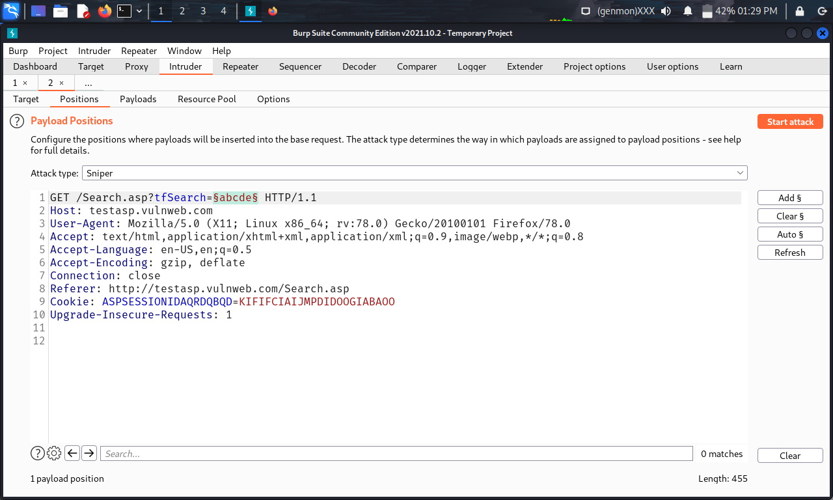

Slide 16
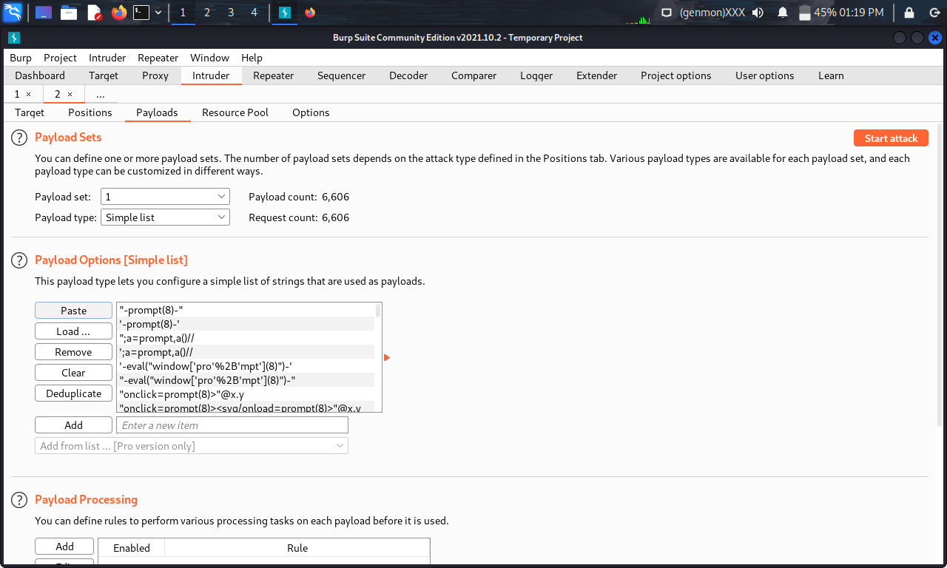

Slide 17
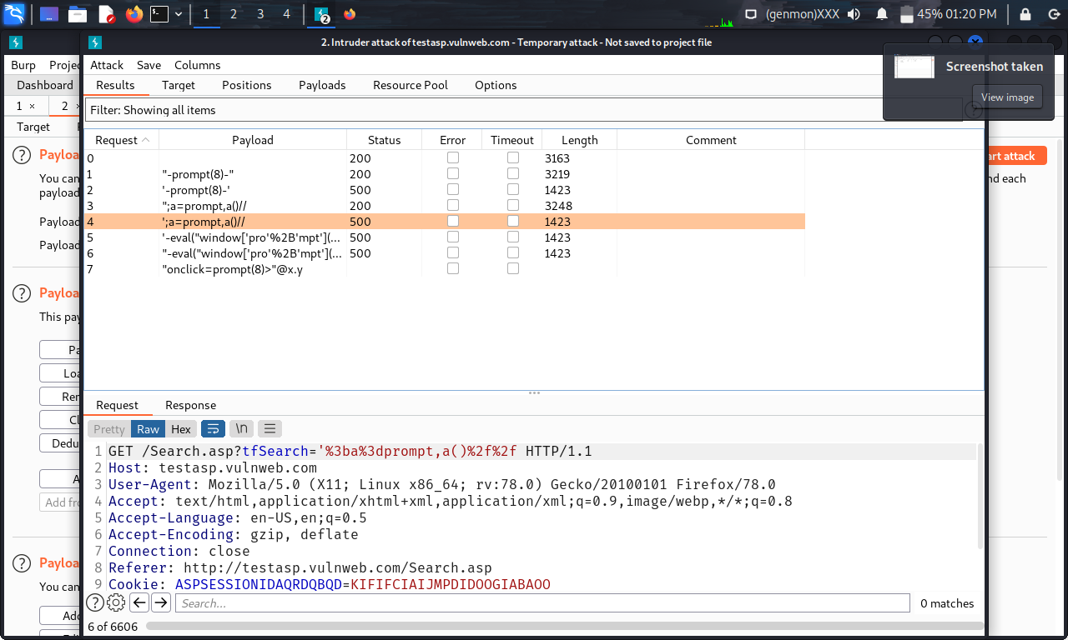

Slide 18
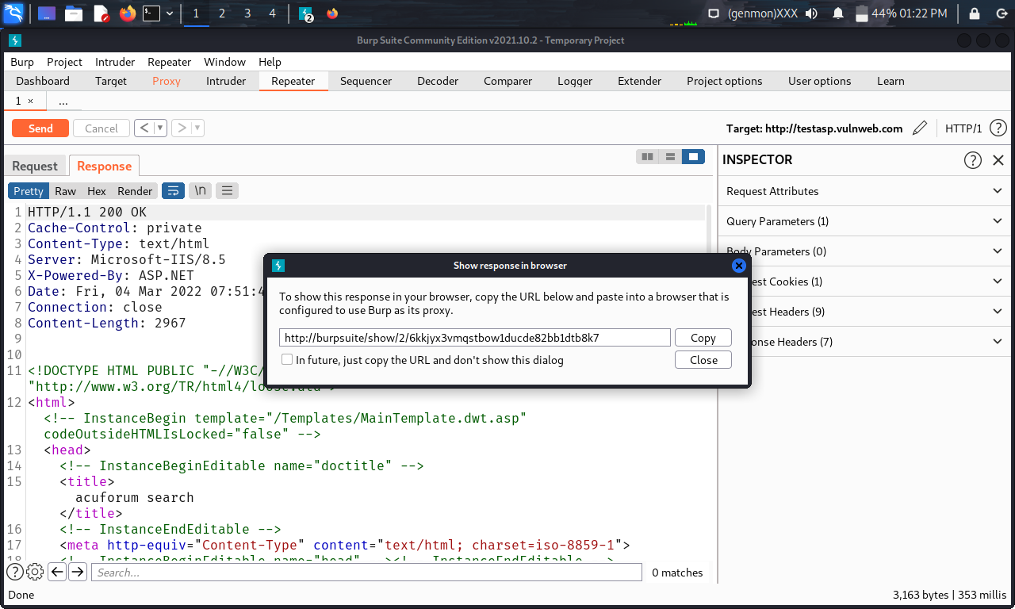

Slide 19
